Slide 1

Future Markets for PHP as a Microlender
Deepak Bhomkar
Eddie Fernandez
Adam Chhibbane

Slide 2

questions
What is PHP?
A non-profit organization
Has a promising and sustainable global rotating savings plan
Provide low-cost access to borrowing to marginalized, ”underbanked” communities
Allows money flow between rich donors to targeted borrowers
What is their requirement?
Identify regions that would benefit from PHP’s plans
Identify target communities within the region
Identify existing costs of borrowing for the above targeted entities
Notes:
What is PHP?
PHP is a global rotating savings plan that wishes to provide low cost, access to borrowing to marginalized, ”underbanked” communities
What is their requirement?
The primary ask from the management is to identify regions that would benefit from PHP’s lending plans
Identify target communities within the regions – this would be like rural/urban or male/female ratios borrowing money
Identify the existing costs of borrowing for the above targeted entities

Slide 3
DATA Challenges
Finding the right source(s) of data
Identifying data parameters to consume from a huge dataset
Identified Microfinance Information Exchange(MIX) Market data
Published by the World Bank
A small part of the entire database provided by World Bank
Provides a wealth of information on a variety of different metrics pertinent to microfinance
Notes:
We debated and researched around 10 hours to identify various data sources in the internet. This was the most tricky part. Once we got one of the metrics the other metrics were not available. A lot of effort went to downloading and analyzing the data from multiple sites. Luck was on our side and we located MIX data from World Bank

Slide 4
Data
Primary focus on these data
Active Borrowers by Country
Amount borrowed by entities
Administrative Borrowing Expenses by Country
Cost of borrowing
Comparison of lending trends in both urban and rural communities
Rural or urban target focus
Notes:
In particular, we narrowed down to these datasets
Active Borrowers by Country
Administrative Expenses by Country
Cost of Borrowing
Comparison of Lending Amounts in both Urban and Rural Communities

Slide 5
Data
Data Sources
Downloaded entire MIX data as csv files
https://databank.worldbank.org/source/mix-market
Download the publicly available latitude and longitude data by country in csv file
https://www.kaggle.com/paultimothymooney/latitude-and-longitude-for-every-country-and-state
Identified countries and time frame from entire data set
Country Set
Afghanistan
Albania
Angola
Costa Rica
Ecuador
Ethiopia
Ghana
Haiti
Kenya
Timeframe
2015
2016
2017
2018
2019
Notes:
We narrowed down our country list to the following
And the timeframe from for a five year term 2015 to 2019

Slide 6
Data clean-up
Data column names did not match actual data
Renamed them appropriately
Columns names were too lengthy or had redundant words
Renamed to concise descriptions
Blank columns with no data
Dropped these columns
Most of the data was appearing as type object
Converted numeric type data to reflect actual numeric values
Character types were converted to numeric type with 0.0
Notes:
Describe the exploration and cleanup process.
Discuss insights you had while exploring the data that you didn't anticipate.
Discuss any problems that arose after exploring the data, and how you resolved them.
Present and discuss interesting figures developed during exploration, ideally with the help of Jupyter Notebook.
Data columns did not match actual data
Country name was mentioned against a org code column, and actual country name was named Level

Slide 7
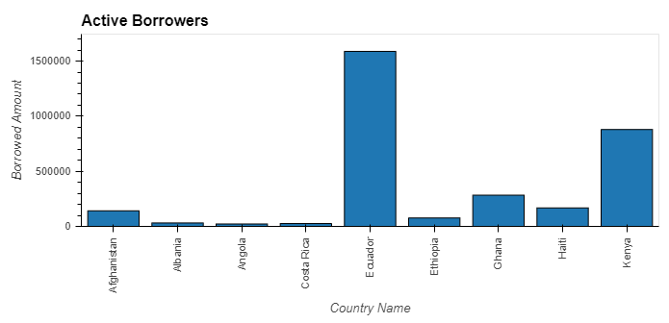
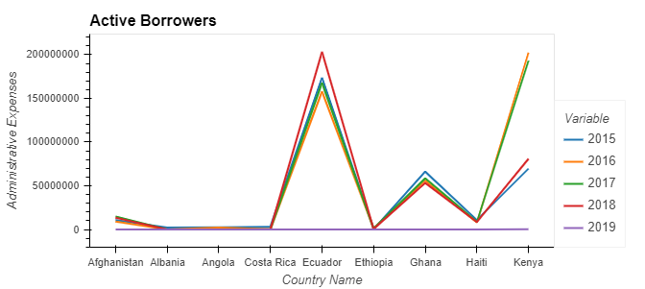
Data analysis
Active Borrowers by Country
Angola and Albania had lower borrowing activities
Ecuador & Kenya had higher borrowing activities
Costa Rica surprisingly had low borrowing activity
PHP can target the following countries
Angola
Albania
Ethiopia
Afghanistan
Notes:
Discuss the steps you took to analyze the data and answer each question you asked in your proposal.
Present and discuss interesting figures developed during analysis, ideally with the help of Jupyter Notebook.

Slide 8
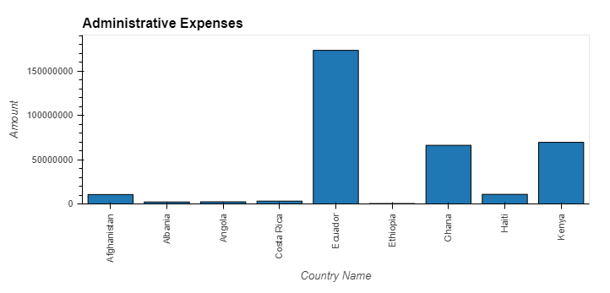
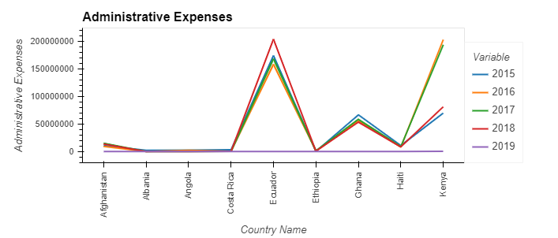
Data analysis
Administrative Borrowing Expenses by Country
Angola and Albania had lower administrative costs
Ecuador, Kenya & Ghana had higher administrative costs
Countries with higher borrowing rate also have higher administrative costs for borrowing
PHP can target the following countries and demonstrate how it can lower costs to borrow
Ghana
Kenya
Haiti
Afghanistan
Notes:
Discuss the steps you took to analyze the data and answer each question you asked in your proposal.
Present and discuss interesting figures developed during analysis, ideally with the help of Jupyter Notebook.

Slide 9
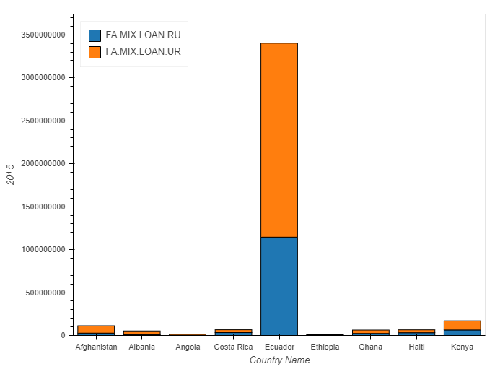
Data analysis
Comparison of lending trends in both urban and rural communities
The urban population ratio was greater than rural for all countries and years
Angola and Albania had no rural population borrower for 2016 onwards
Angola and Albania had low borrower population for both urban and rural
PHP can target the following countries for rural population penetration
Angola
Albania
Ethiopia
Haiti
Notes:
Discuss the steps you took to analyze the data and answer each question you asked in your proposal.
Present and discuss interesting figures developed during analysis, ideally with the help of Jupyter Notebook.

Slide 10
Panel
Panel Show

Slide 11
Conclusion
Angola, Albania & Ethiopia could be the target regions that PHP may prioritize working in these countries
Costa Rica is more developed of a country than the rest of the countries selected
One of the lowest number of active borrowers
Signifies that relatively wealthier countries can have large underbanked communities
PHP could focus on Costa Rica as an exception based on further study of related parameters to see why it lags behind in borrowing
Notes:
Discuss your findings. Did you find what you expected to find? If not, why not? What inferences or general conclusions can you draw from your analysis?

Slide 12
conclusion
Administration fees were comparatively higher in Ecuador relative to other countries in the sample pool
Perhaps the most noteworthy, even though unsurprising, metric we saw was the difference between numbers of borrowers in rural areas compared to urban areas

Slide 13
Future
Enhance tool to accept countries and timeframe
Add more parameters to analyze and provide calculated results

Slide 14
Q & A

